Slide 1
Mini Project On Predicting Mall Customer Segmentation using Clustering Techniques

Slide 2
Problem Statement
Customers who come for in a mall can be grouped in a number of ways. Shopping pattern, spending pattern, shopping score, salary etc are some of the factors that can be used to divide the customers into different categories.
The reason for these clusters is to help identify those customers who would be interested in certain products, offers and services.
The store may strategize its offerings in such a way that it targets only right customers for specific products.
This helps in creating a win-win situation for both the store (in terms of revenue and more customers through customer recommendation) and the customer (discounts, offers, reward points, gifts, etc)

Slide 3
Business Objective
To create Customer cluster to identify the different types of customers

Slide 4
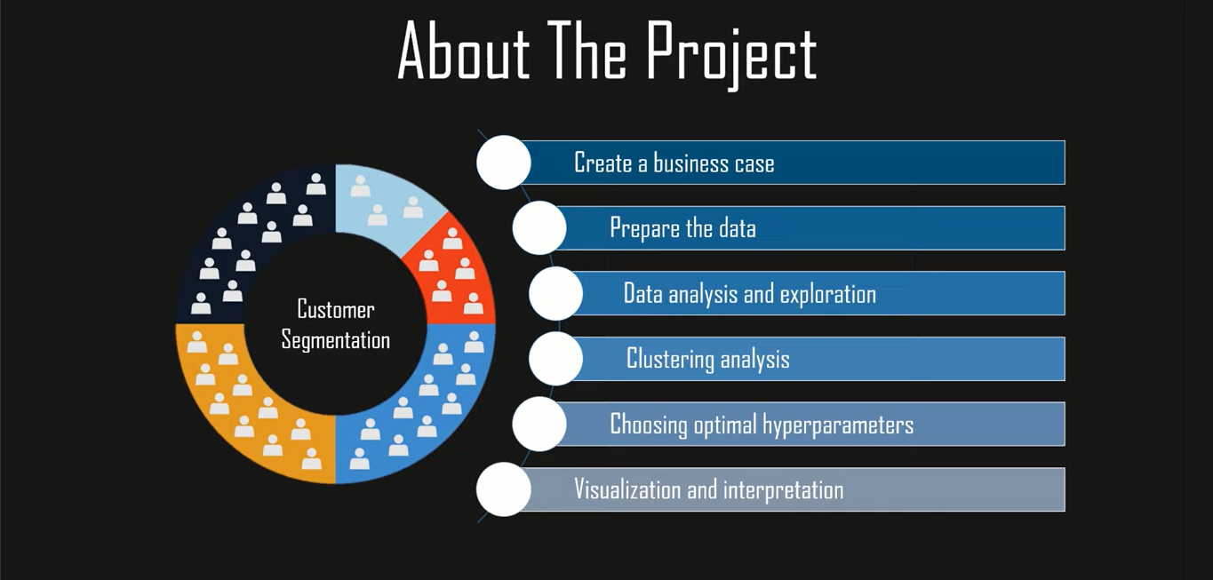

Slide 5
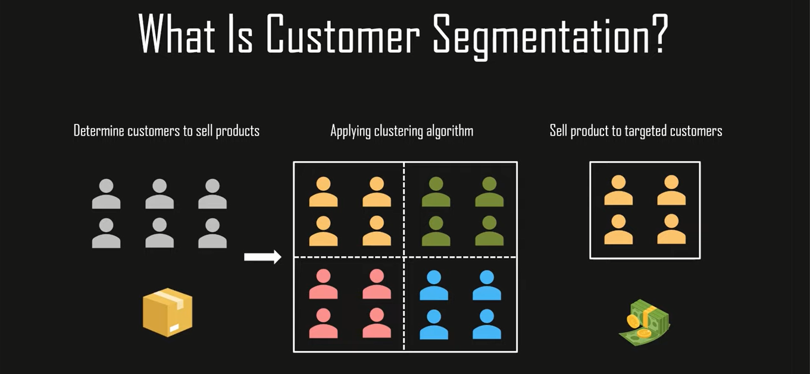

Slide 6
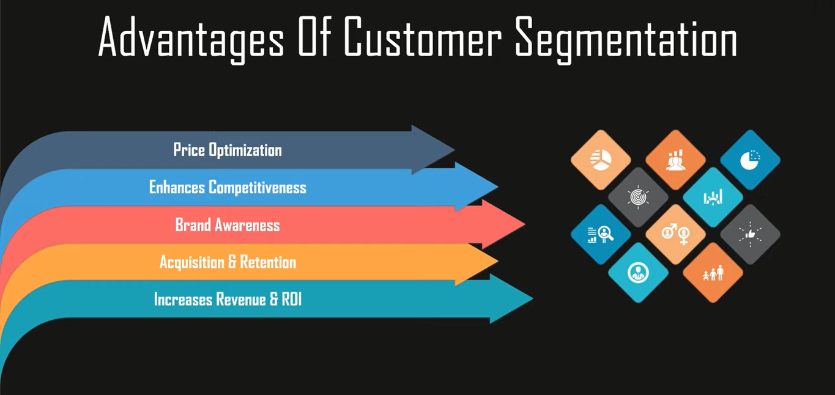

Slide 7
Selection of Machine Learning Algorithms
We have used K-Means Clustering algorithm to train our model.
K-Means clustering is an unsupervised machine learning algorithm that divides the given data into the given number of clusters. Here, the “K” is the given number of predefined clusters, that need to be created.
It is a centroid based algorithm in which each cluster is associated with a centroid. The main idea is to reduce the distance between the data points and their respective cluster centroid.
The algorithm takes raw unlabeled data as an input and divides the dataset into clusters and the process is repeated until the best clusters are found.

Slide 8
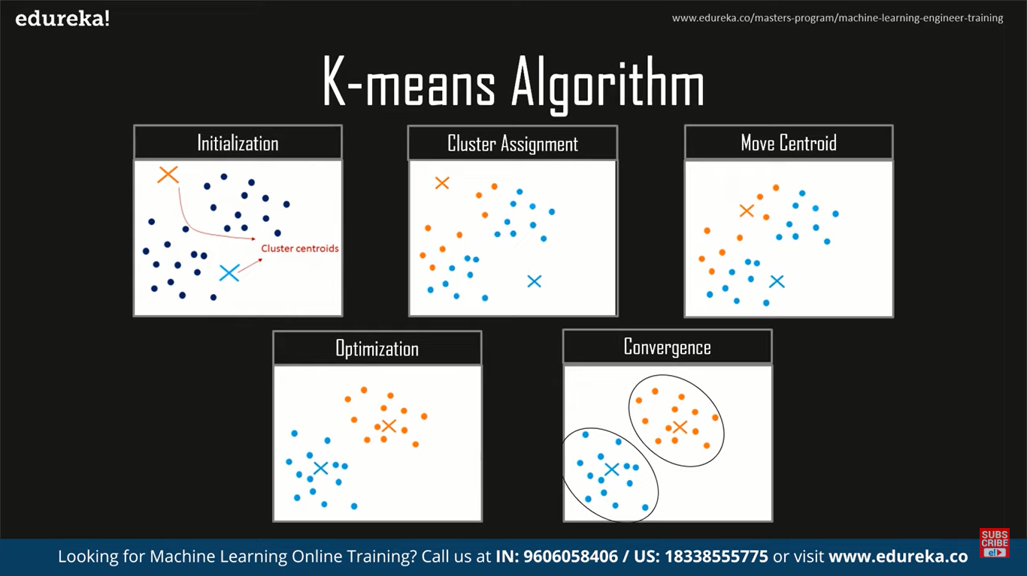
Steps To Execute KMeans Algorithm

Slide 9
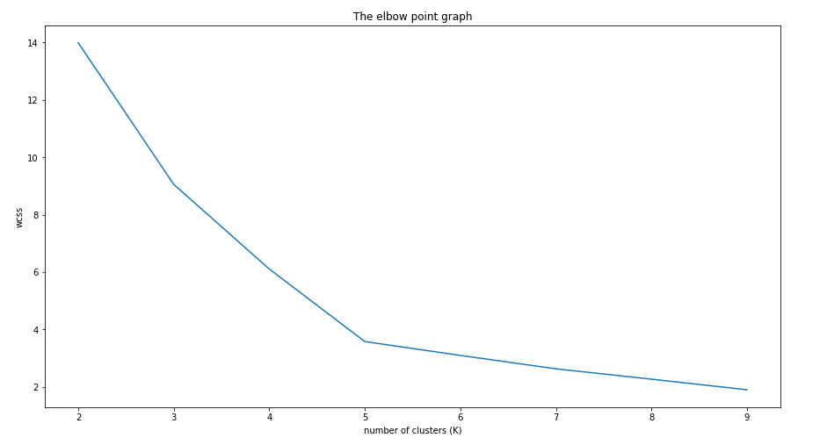
Elbow Curve To decide The Optimal Value Of K
wcss dosen't reduce much after k=5.So, we can choose 5 as the perfect k value or Clusters

Slide 10
Silhouette score to validate the cluster
For n_clusters = 2 The average silhouette_score is : 0.33340205479521 For n_clusters = 3 The average silhouette_score is : 0.4514909309424474 For n_clusters = 4 The average silhouette_score is : 0.49620078745146784 For n_clusters = 5 The average silhouette_score is : 0.5594854531227246 For n_clusters = 6 The average silhouette_score is : 0.5354954062577636 For n_clusters = 7 The average silhouette_score is : 0.5168021892187427
From Silhouette score calculated we can make out that highest Silhouette score
Is For n_clusters = 5

Slide 11
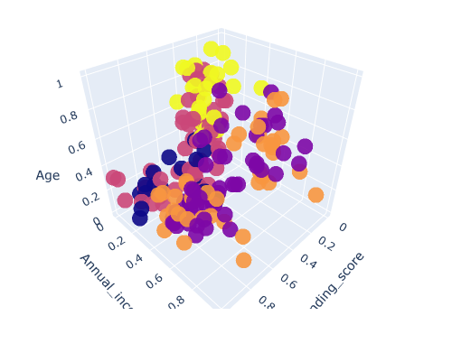
1) Yellow Cluster - The yellow cluster groups young people with moderate to low annual income who actually spend a lot. 2) Purple Cluster - The purple cluster groups reasonably young people with pretty decent salaries who spend a lot. 3) Pink Cluster - The pink cluster basically groups people of all ages whose salary isn't pretty high and their spending score is moderate. 4) Orange Cluster - The orange cluster groups people who actually have pretty good salaries and barely spend money, their age usually lays between thirty and sixty years. 5) Blue Cluster - The blue cluster groups whose salary is pretty low and don't spend much money in stores, they are people of all ages.

Slide 12
Conclusions
After developing a solution for this problem, we have come to the following conclusions:
K-Means Clustering is a powerful technique in order to achieve a decent customer segmentation.
Customer segmentation is a good way to understand the behavior of different customers and plan a good marketing strategy accordingly.
There isn't much difference between the spending score of women and men, which leads us to think that our behavior when it comes to shopping is pretty similar.
Observing the clustering graphic, it can be clearly observed that the ones who spend more money in malls are young people. That is to say they are the main target when it comes to marketing, so doing deeper studies about what they are interested in may lead to higher profits.
Although younglings seem to be the ones spending the most, we can't forget there are more people we have to consider, like people who belong to the pink cluster, they are what we would commonly name after "middle class" and it seems to be the biggest cluster.
Promoting discounts on some shops can be something of interest to those who don't actually spend a lot and they may end up spending more!

Slide 13
Business Conclusion
Promoting discounts on some shops can be something of interest to those who don't actually spend a lot and they may end up spending more

Slide 14
THANK YOU

